Slide 1
Imperatives
Basic 10

Slide 2
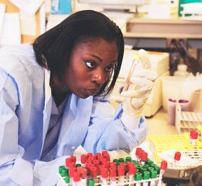
13-6 IMPERATIVE SENTENCES
Please go outside and talk on your cell phone.
I’m working.

Slide 3
13-6 IMPERATIVE SENTENCES
(a) Please be quiet. I’m working.
an imperative sentence
I want you
to be quiet.

Slide 4
13-6 IMPERATIVE SENTENCES
(b) Stand up.
(c) Close the door.
Imperative uses the base form of verb.

Slide 5
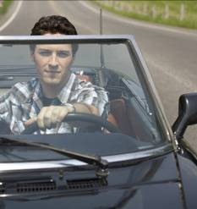
13-6 IMPERATIVE SENTENCES
(d) Don’t drive so fast.
(e) Don’t go out tonight.
don’t + simple form of verb

Slide 6
13-6 IMPERATIVE SENTENCES
(f) ORDERS: Come here, Jan.
(g) DIRECTIONS: Add two cups of flour.
(h) ADVICE: Don’t be upset.
(i) REQUESTS: Please give me the rake.
polite
request
please

Slide 7
13-6 Let’s Practice
Imperative verbs
Jenna: Please go to the store.
Scott: Okay, what do we need?
Jenna: Buy some milk and bread.
Scott: Okay, but don’t start the
movie without me.

Slide 8
13-6 Let’s Practice
Imperative verbs
Alex: Close the gate.
Tara: Don’t worry, I will.
Alex: Please do it now.
Tara: Why?
Alex: The horse is trying to get out.

